Slide 1
Drones in Warehousing: Our Recommendations for the Apollon Company
A market research paper compiled by Wendy Obispo, Alex Lam, Allyson Ramirez-Garay, Liz Fischer, and Zacharias Beck.
Hayri Erkan Ozkaya, Ph.D
IBM 4990.03
8 December 2023

Slide 2
Industry Summaries
Defining the Market & Addressing Key Challenges

Slide 3
Disaster Management
Notes:
WENDY OBISPO

Slide 4
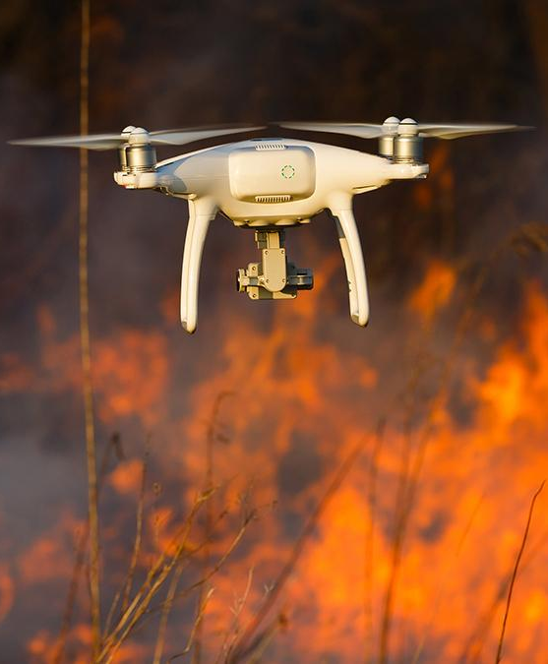
Disaster Management
Provide real time imagery and data collection during disasters
Expected to grow at CAGR of 13.1% between 2023-33
Issues:
Not all drones can fly through various weather conditions
limited battery life
privacy issues as people may be more vulnerable to exploitation in disaster moments
Notes:
WENDY OBISPO

Slide 5
Competitors
DJI
high resolution digital and thermal cameras
Able to see at night or low-light situations
Parrot
does not have any geofencing
180-degree tilt
easy-to-use drones
Aeryon Labs
all-weather drones
withstand higher wind speeds
Notes:
WENDY OBISPO

Slide 6
Environmental Monitoring
Notes:
WENDY OBISPO

Slide 7
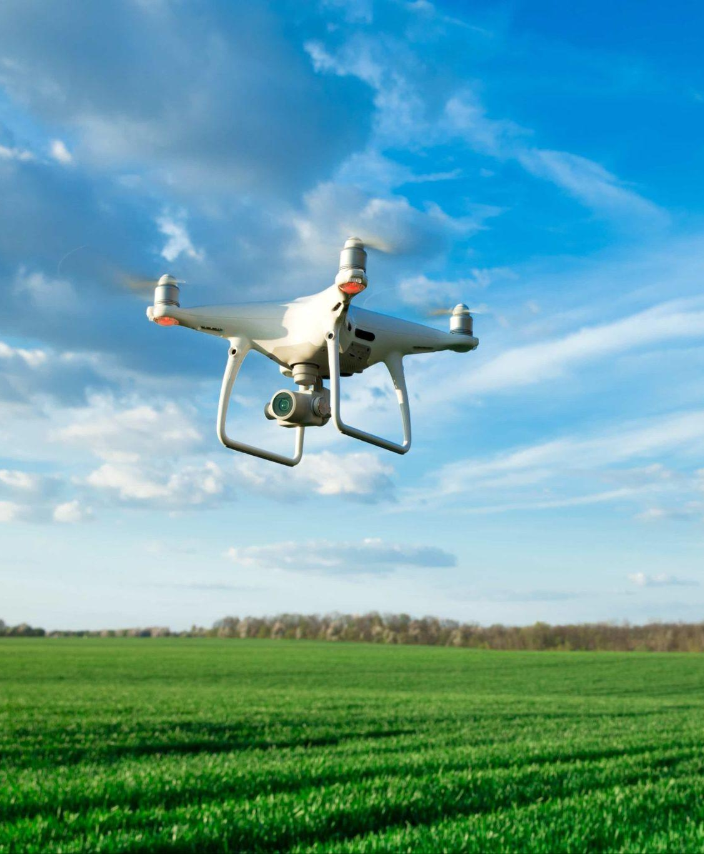
Environmental Monitoring
See any changes in environment, mapping environments
Multispectral imaging allows drones to capture various images in different bands of the electromagnetic spectrum which in turn allows for an analysis of the environment
Issues:
Potential negative environmental impact
Notes:
WENDY OBISPO

Slide 8
Competitors
Wingtra
flight time of 59 minutes
accurate multispectral images
SenseFly
flight time of 90 minutes
built-in management software which can help with data captures
DJI
multispectral sensors which can help with mapping forests
can classify water bodies, estimate water coverage, and monitor sewage
Notes:
WENDY OBISPO

Slide 9
Insurance and Risk Assessment
Notes:
WENDY OBISPO

Slide 10
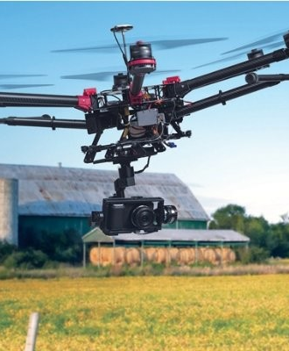
Insurance and Risk Assessment
Property Damage assessment, safety inspections, claims processing efficiency
By 2027, drones in the insurance and risk assessment industries are expected to grow at a rate of about 8.4%
Issues:
Limits in flight altitude
bodily injuries
Privacy concerns
Notes:
WENDY OBISPO

Slide 11
Competitors
Yuneec
precise flight, rapid change of imaging systems, and clean and accurate images
PrecisionHawk
artificial intelligence technology which helps with machine learning.
they are the only service provider that is authorized by the FAA, federal aviation administration, to fly drones above the visual line of sight.
SkyCatch
proprietary photogrammetry technology
“a method of approximating a three-dimensional (3D) structure using two dimensional images.”
automation in drone capture of images
Notes:
WENDY OBISPO

Slide 12
How can Apollon Company solve these issues?
AI integration
Easy-to-use software
Better sensors
Enhanced battery life

Slide 13
Search and Rescue
Notes:
Zacharias Beck

Slide 14
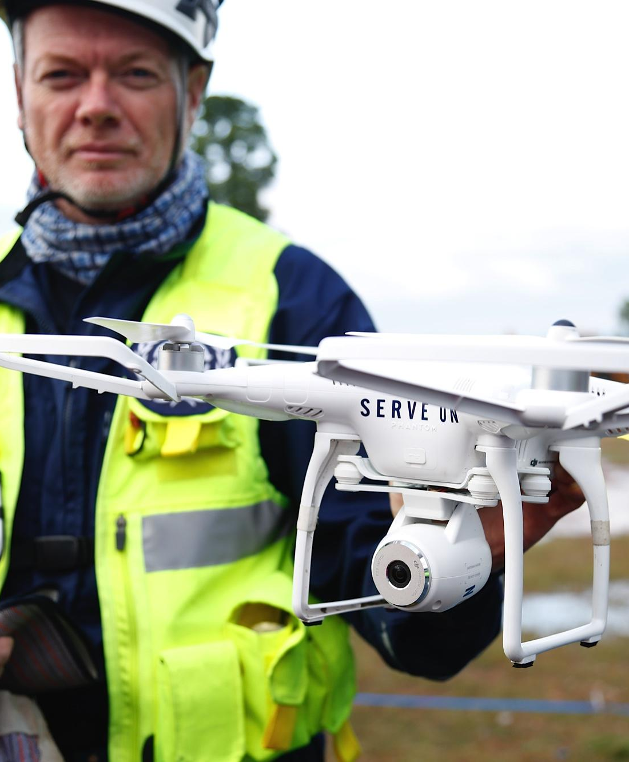
Search and Rescue
Covering large areas in search of missing persons or survivors, being used as communication relays, or assessing hazardous situations
According to a report from FactMR in 2022, the global search and rescue drone market had a market size of 2.8 billion, with a Compound Annual Growth Rate (CAGR) of 13.6%
Issues:
Level of training
Battery length
Connectability
Notes:
Zacharias Beck

Slide 15
Competition
DJI:
Modular drones with specialized attachments for flexibility.
Adaptable for various applications through sensor and tool attachments.
Comprehensive product range and ecosystem for diverse user needs.
Industry leader in drone innovation and technology.
Aerotronics:
Innovative modular design for durability.
Weather-tested for reliability in extreme conditions.
Long-lasting enhancements, reducing replacements.
Produces dependable drones for demanding situations.
Notes:
Zacharias Beck

Slide 16
Public Safety, Security, Surveillance
Notes:
Zacharias Beck

Slide 17
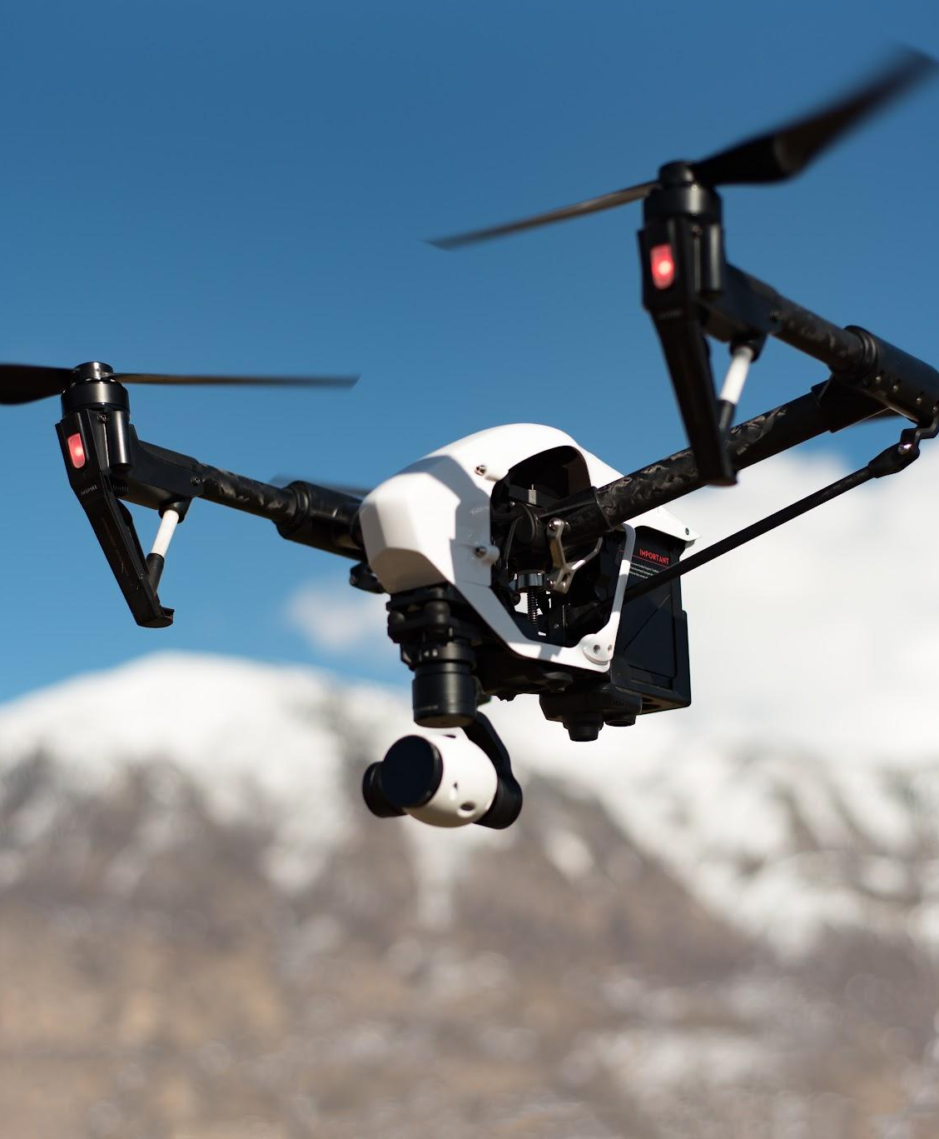
Public Safety, Security, Surveillance
Use of drones for police, security, and public safety operations, including crowd monitoring, traffic control, border surveillance, search and rescue, disaster response, and firefighting
According to a report published by MarketsandMarkets in 2023, the global public safety drone market was estimated to have a market size of 1.1 billion, with a projected Compound Annual Growth Rate (CAGR) of 13.0%
Issues:
Level of training
Battery length
Notes:
Zacharias Beck

Slide 18
Competition
Draganfly/Lufthansa Industry Solutions Merger:
Expertise in AI-powered maritime cargo inspections.
Offers comprehensive solutions for various industries, including maritime logistics.
Iron Drone:
Advanced security drones intercept rogue drones without jamming.
Trusted solution for airspace protection.
Skydio:
Versatile drones for fire, police, and emergency services.
Strong cybersecurity for data integrity and trust in operations.
Notes:
Zacharias Beck

Slide 19
Agriculture
Notes:
Zacharias Beck

Slide 20
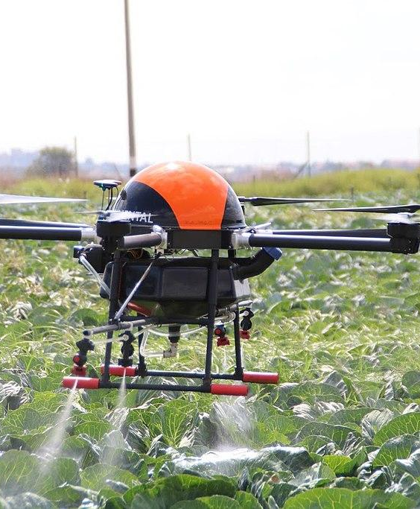
Agriculture
Use of drones for crop management and yield efficiency, used to monitor large fields quickly and provide data for better informed models
According to a report by Fortune Business Insights in 2022, the global agriculture drones market reached a market size of 4.2 billion with a Compound Annual Growth Rate (CAGR) of 20.30%
Issues:
Price
Battery length
Weather Interference
Notes:
Zacharias Beck

Slide 21
Competition
AeroVironment:
Develops hybrid drones for autonomous scanning and data collection.
Provides data-driven field change recommendations.
Covers over 45 acres in a 45-minute flight for enhanced data collection.
DJI:
Efficient fertilizer spreading at 1.5 Tonnes per hour.
Versatile for various operations, including mapping and surveying.
Established and reliable brand in the drone industry.
AgEagle:
Specializes in fixed-wing drones for precise agricultural data collection.
Supports detailed mapping, water management, crop monitoring, yield prediction, and plant counting.
Enhances overall agricultural management efficiency.
Notes:
Zacharias Beck

Slide 22
Inspection and Monitoring
Notes:
Alex

Slide 23
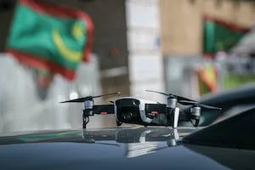
Inspection and Monitoring
Accumulate visual data, aid avoiding hazardous areas (chemical spills, tall, lean towers). With their features, they can detect any future dangers and movements within the facility.
According to a report published by MarketsandMarkets in 2022, the global inspection and monitoring market was estimated to have a market size of 11.6 billion, with a projected Compound Annual Growth Rate (CAGR) of 14.6%
3 Issues:
Limited Battery
Climate and Weather
Object scales, angle variations
Notes:
Alex

Slide 24
Competitors
Maverick Inspection LTD
Detect any methane leaks
Create maps and models as a blueprint for visualization on infrastructures (bridges, manways, decks)
GarudaUAV Soft Solutions Pvt. Ltd.
Gather data with urban planning to understand current and future state of urban areas
Analyze movements of people and have immediate response for emergency
Dronedeploy, Inc
Strong detections on any dangers that may put the worker’s life at risk
Creations on analysis and validations for quality work of structural elements and sharable edit reports with the team in real-time
Notes:
Alex

Slide 25
Mapping/Surveying/GIS
Notes:
Alex

Slide 26
Mapping/Surveying/GIS
Site topography including inspection surveying and others that cover various Industries such as agriculture, construction, public safety, etc. The global market size is 1 billion as of 2023 and CAGR 17.10%
The primary issues in this industry are FAA regulations and it is a fragmented Market.
Construction uses a lot of very expensive equipment and drones can be used to track and monitor that the equipment is being used and stored properly along with employee activities. In agriculture drones can map out fields for planting, track the continued health of crops and the health of livestock. In public safety you can use the information accumulated to gather Road information and recreate the scene of an accident using 3D imaging.

Slide 27
Competitors
3D Drone Mapping
Long range drones
custom built for African weather conditions
vertical landing and takeoff
ABJ Drones
2500 Pilots globally in North America, Europe and Asia
Accommodate both large and small companies
Inspect infrastructure like building cell towers power line solar and wind farms from the way land surveying is done to 3D modeling of construction sites advances in drone technology are pushing boundaries and enabling innovation
Generate terrain models that extend under water
Aerial Robotix
Specialized in low altitude aerial photography with a geometrically calibrated camera
Extremely fast and efficient calculations

Slide 28
Construction and Infrastructure
Notes:
Alex

Slide 29
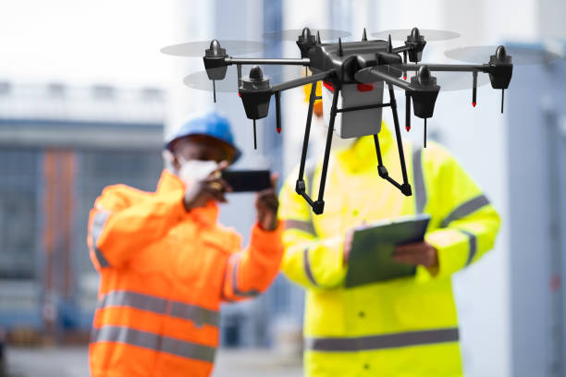
Construction and Infrastructure
Secure and monitor materials, people, and equipment for safety and security purposes
According to a report published by Straits Research in 2021, the global construction drone market was estimated to have a market size of 4.9 billion, with a projected Compound Annual Growth Rate (CAGR) of 15.57%
Top 3 Issues
Limited Flight Time
Low Battery Life
Costly in terms of features of Drones
Notes:
Alex

Slide 30
Competitors
Leptron Unmanned Aircraft Systems, Inc.
Accumulates and creates highly accurate site data for construction work
The merger creates a powerful synergy, offering comprehensive solutions for various industries, including maritime logistics.
DJI
Can easily takeoff and fly over complex worksites with the collected highly accurate data
Creates 3D models with accurate positioning data to visualize data and generate better route designs with most softwares
Notes:
Alex

Slide 31
Photography and Cinematography

Slide 32
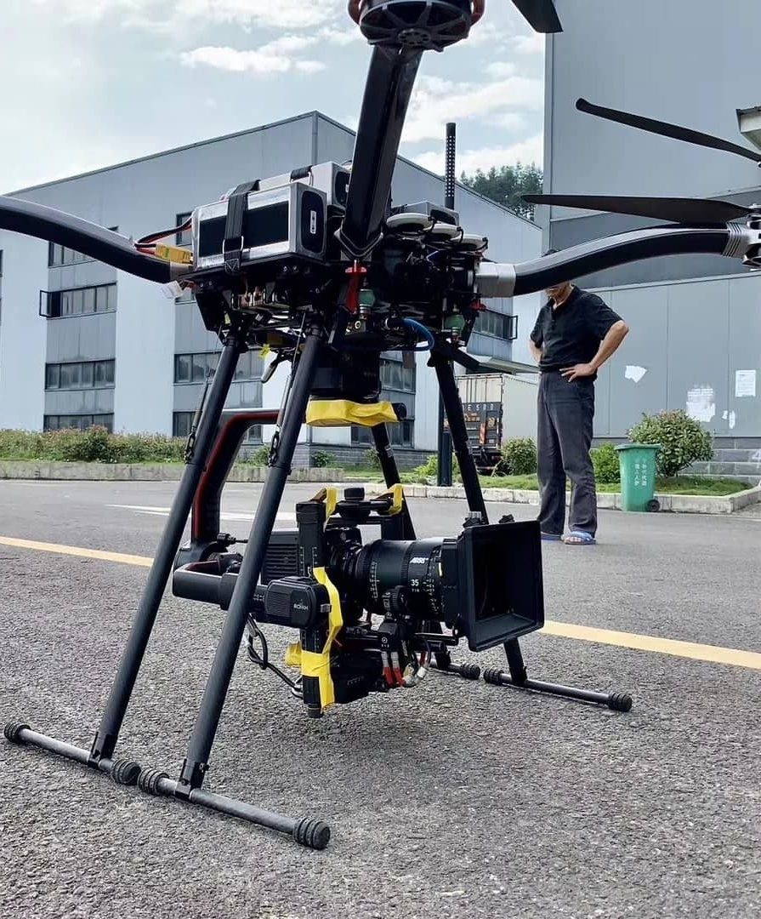
Photography & Cinematography
The use of drones within this industry involves two sectors: filming for content purposes within the film industry & location scouting prior to filming content. Drone requirements for this industry include weight bearing drones, high quality images, and high-flying speeds without heavily impacting image quality. Additionally, this industry is privileged with FAA exemptions that allow for more flexibility to use drones within set operations.
The overall drone camera market size for 2022 was $600 million. This industry also had a Compound Annual Growth Rate (CAGR) of 18.7% in 2022
Issues
Loss of focus and image quality
Disturbance of natural wildlife
Loss of connection
Notes:
Allyson Garay

Slide 33
Competitors
DJI
Several features included with the drone such as AI and VR.
Interchangeable batteries that allow drones to be back in the air quickly during filming.
More affordable than other companies while still providing high quality.
Helinet
Expansive camera integration while maintain high speeds of up to 58mph.
Preplanned coordination and flight paths that maintain efficiency as well tracked maneuvers that help decrease battery usage.
Freefly
Works with cinematographers to design drones that have the functions, capabilities, and quality needed for filming.
Their drones have intelligent autopilot sensors to aid in position accuracy; they are also weight bearing which allows for heavy high-quality cameras.
Notes:
Allyson Garay

Slide 34
Package Delivery
Notes:
Zacharias Beck

Slide 35
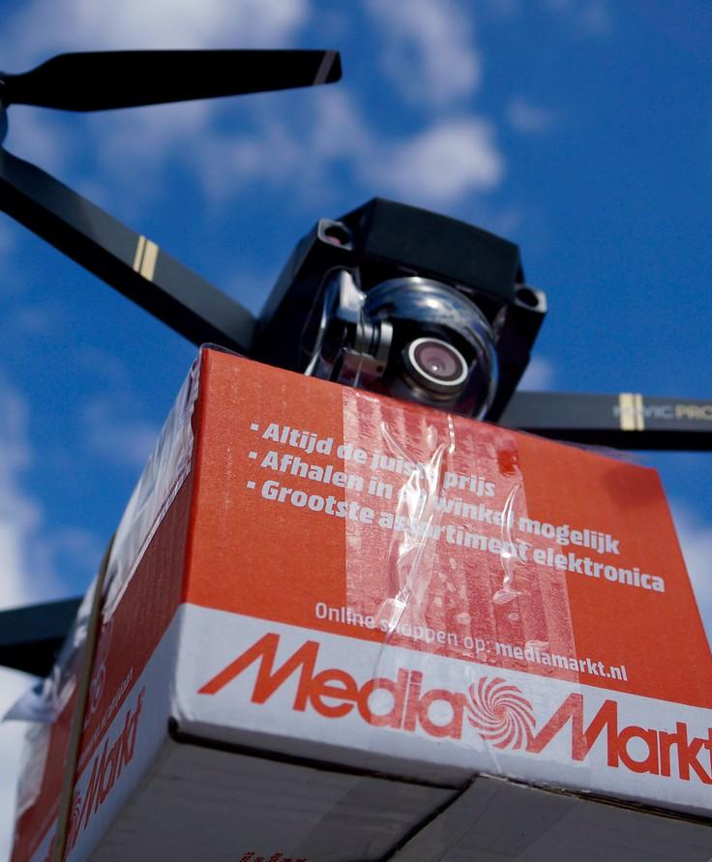
Package Delivery
Drones being used to revolutionize the way goods are transported and delivered. This has the potential to reduce delivery times, lower costs, and minimize the environmental impact associated with traditional delivery methods, making it an exciting development in the logistics and e-commerce sectors.
According to a report from Fortune Business Insights, the global drone package delivery market had a market size of 1 billion in 2020. With a projected Compound Annual Growth Rate (CAGR) of 53.93%
Issues:
Regulations
Cost
Notes:
Zacharias Beck

Slide 36
Competition
Matternet Inc.:
Drones with automated payload and battery exchange for efficient deliveries.
Proprietary software for autonomous drone operation and monitoring.
Achieved FAA Type Certification, meeting regulatory compliance.
Wingcopter GmbH:
Fail-safe power train with 8 motors and 2 batteries for safety.
Multiple cameras and AI for obstacle detection and risk assessment.
Wingcopter 198 can deliver multiple packages in one flight, reducing costs.
Zipline Inc.:
Simple software integration for operational efficiency.
Hybrid design for precise and quiet operation in various weather.
P2 Zip drone delivers up to 8-pound packages with precision, even to small spaces.
Notes:
Zacharias Beck

Slide 37
Warehousing
Notes:
Zacharias Beck

Slide 38
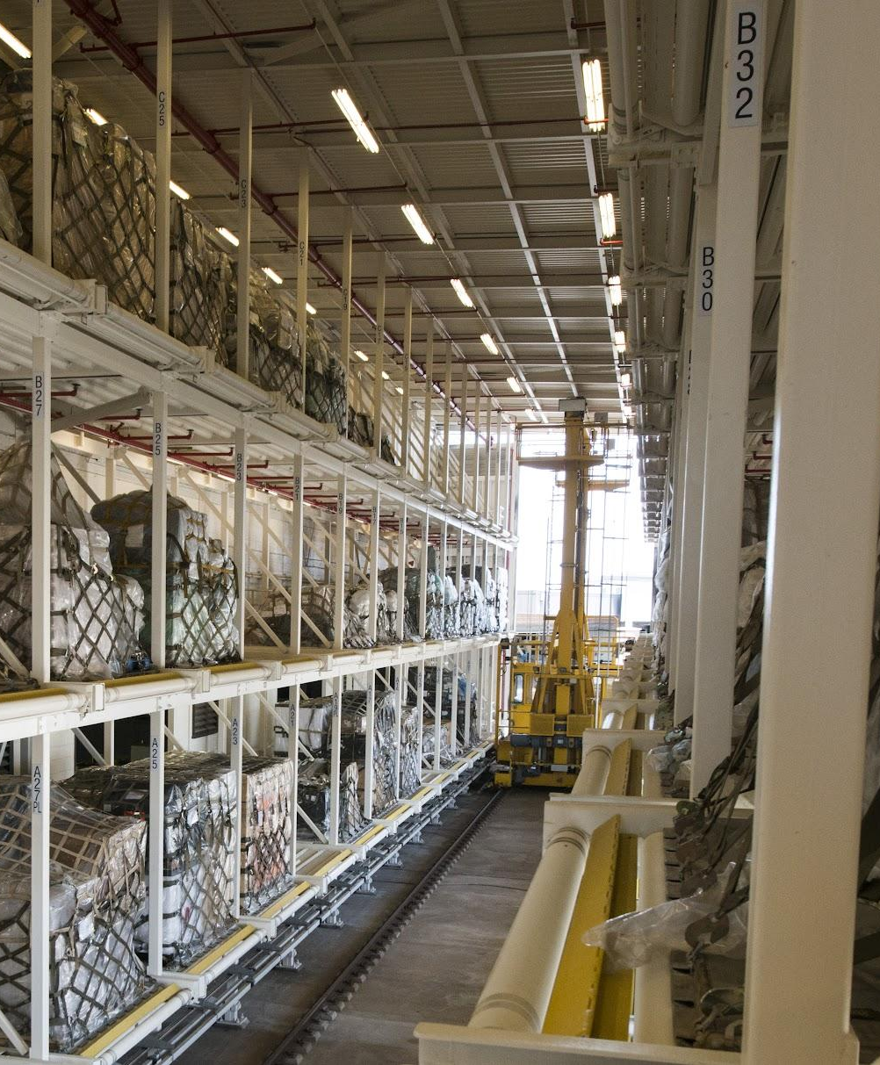
Warehousing
Drones used for tasks such as inventory management, surveillance, and inspection. They navigate storage facilities efficiently, automate tasks like cycle counting, and enhance security through real-time surveillance, contributing to streamlined operations and improved accuracy
According to Fortune Business Insights, the global drone package delivery market reached a market size of 1.0 billion in the year 2020. Expected Compound Annual Growth Rate (CAGR) of 53.94% in the coming years
Issues
Marketing
Cost
Notes:
Zacharias Beck

Slide 39
Competitors
Skydio:
Automated drones for warehouse inventory enhancement.
Maps warehouses, follows designated routes, and captures data quickly.
AI-driven navigation identifies objects, avoids obstacles for safe operation.
Doks:
Drones with powerful sensors for label and document reading in warehouses.
Night flight mode for low-light conditions.
Creates digital replicas of shelves for precise data organization.
Verity:
Drones create digital models of warehouse racks for accurate inventory management.
Operate autonomously with online scan scheduling.
Detects item movements, generates reports, and provides real-time inventory data on Verity cloud software.
Notes:
Zacharias Beck

Slide 40
Utilities and Renewable Energy
Notes:
Zacharias Beck

Slide 41
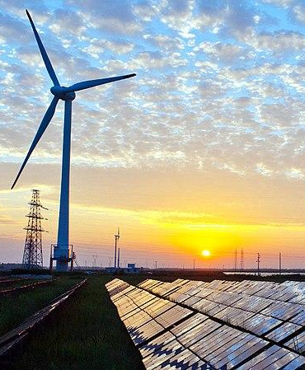
Utilities and Renewable Energy
Drones utilized for inspecting and maintaining critical infrastructure like power lines, wind turbines, and solar panels. Additionally, drones collect essential data, such as environmental conditions and equipment performance, aiding in resource management. Their use enhances safety, minimizes operational downtime, and contributes to the growth and sustainability of these industries.
According to a report on Yahoo Finance, the global utility drone market had a value of 0.26 billion in the year 2022, and it is expected to grow at a Compound Annual Growth Rate (CAGR) of 28.7%
Notes:
Zacharias Beck

Slide 42
Competitors
DJI:
Matrice 210 RTK V2 with XT2 thermal payload for solar farm inspections.
Mavic 2 Enterprise Advanced and Matrice 300 RTK for wind turbine inspections.
Matrice 210 RTK V2 and Matrice 300 RTK for utility leak detection and repairs.
BRAQ Industries:
Trained pilots for challenging environments.
Software simplifies operations, including picture management, annotations, and flight planning.
Offers corridor mapping services for critical infrastructure.
Skydio:
Introduces 3D Scan technology for automated flight paths and on-site modeling.
Skydio X10 with Night Sense for nighttime operations.
VT300-L attachment with multiple cameras and built-in flashlight.
Notes:
Zacharias Beck

Slide 43
Forestry
Notes:
Alex

Slide 44
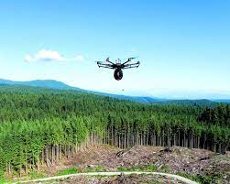
Forestry
Overlook any future dangers (fires, pest, disease) created in the forest and harvest planning. Promote the health and wellbeing of our forests by quickly identifying the presence of smoke and preventing a potentially catastrophic fire.
The global market is approximately 1 billion as of 2022 and the CAGR is 37%
Top 3 Issues
Exhaustive process - requires huge amount of workforce and skills
Disturbance - place where to avoid human interference
Life-span - 11% of birds attack drones
Notes:
Alex

Slide 45
Competitors
AgEagle:
Remote sensing quickly survey large areas and automate the generation of tree parameters
Analyzes the causation of prevalent forest disturbances
detecting new trees, monitoring growth and determining health assessments
TimberDrone:
high-resolution cameras to produce custom aerial photographs and videos
Provides a permanent record of site conditions that can be shared with others
imagery shows current condition of the drone.
Quadrocopter:
collect data overhead from log yards, pulp mills, wood chip piles, to help manage inventory levels
images taken access present and past imagery to compare inventory in the yard changes
understand yard and what needs to be done to provide usable data
Notes:
Alex

Slide 46
Mining
Notes:
Alex

Slide 47
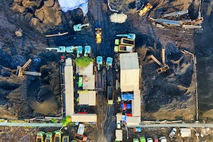
Mining
Drones are used for exploration, surveying, and mapping to maintaining safety and enhancing security
Market Size (2017): 4.8 Billion
CAGR: N/A
Top 3 Issues
Defining and capturing accuracy
Safety and regulations
Hiring and Training staff
Notes:
Alex

Slide 48
Competitors
Wingtra:
Surveying, mapping, and monitoring
Collect high resolution aerial data
Contour mapping
Flyability:
Drones capable of navigating complex and tight spaces
Ensuring safety and efficiency of mining operations
Data collection of hazardous environments.
Delta Drone International:
Aerial imagery and mapping
Environmental monitoring
Stockpile volume measurement
Notes:
Alex

Slide 49
Plane Inspection
Notes:
Zacharias Beck

Slide 50
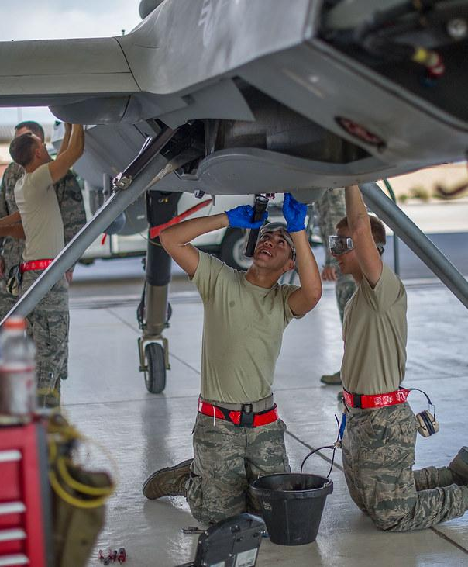
Plane Inspection
The use of drones is revolutionizing plane inspections by offering a safer, faster, and more efficient alternative to traditional manual checks. Equipped with high-resolution cameras and sensors, drones can closely examine aircraft exteriors for damage or wear, capturing detailed images of hard-to-reach areas like the upper fuselage and tail. This technology significantly reduces the inspection time, allowing for more frequent and thorough checks without the need for scaffolding or lifts. The data collected by drones can be analyzed using advanced software, leading to more accurate and timely identification of potential issues.
According to a report by MarketsandMarkets, the global drone inspection and monitoring market had a market size of 11.6 billion in 2022, with a Compound Annual Growth Rate (CAGR) of 11.6%
Notes:
Zacharias Beck

Slide 51
Competitors
Boeing:
Respected player in aerospace industry.
Military drone expertise hints at future innovations.
Mainblades:
Comprehensive, user-friendly drone service.
Off-the-shelf package for broader business adoption.
Emphasis on ease of use and accessibility.
Donecle:
Precision with machine learning and advanced image processing.
75% faster inspection than traditional teams.
Disruptive automation for cost-efficiency and improved efficiency.
Notes:
Zacharias Beck

Slide 52
Oil and Gas

Slide 53
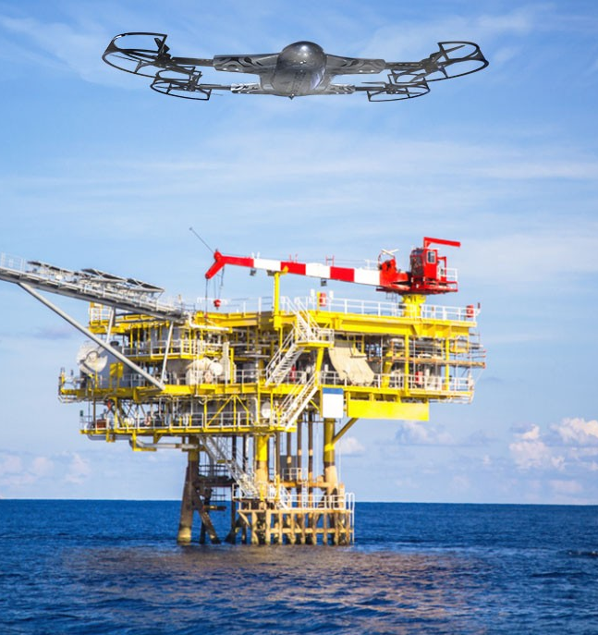
Oil & Gas
This industry uses drones to oversee any mishaps such as spills, damage, and pipelines for oil and gas companies. The data and images collected from these drones are used for analysis of efficiency as well as preventative measures needed for safety.
According to Market, Research, Future the market size for the year 2022 was of $10.3 billion. It also has a CAGR of 39.1% due to advancements in AI technology integration.
Issues
Surveying of hazardous areas involving the batteries used for drones.
Another issue within this industry concerns the vibrations caused by winds/harsh climate conditions.
Lastly, rough terrains and remote locations are an issue for drones due to the short bandwidth available for connection.
Notes:
Allyson Garay

Slide 54
Competitors
DJI
They have advanced technology that allows them to accommodate each industry.
For gas and oil inspections they provide specialized sensors that can detect leakages as well as provide a digital 2D/3D map model of the inspected structures.
Aerial Production Services, Inc.
They have high resolution imagery and video of the data captured which helps with accuracy and prediction analysis.
American Robotics
Continuously monitors the structures with long lasting batteries, this helps in long term data collection.
Notes:
Allyson Garay

Slide 55
Meteorological Drones and Sensors

Slide 56
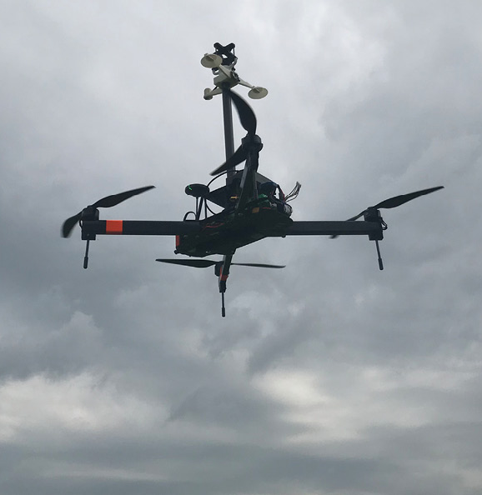
Meteorological Drones
Drones within this industry allow for assessment of weather conditions; specifically, wind speed and direction due to climate change. The data these drones collect also aids in weather prediction and accurate forecasting.
The estimated market size for the year 2021 was roughly $2.3 billion. This was found by multiplying 1.4 billion registered drones by the market size of anemometer sensors $164 million (which are the primary sensors used on all meteorological drones). The CAGR for that same year was 24.5%.
Issues
Low battery life
Anemometers do not work well with the drone’s hardware and functions.
Harsh weather conditions can affect sensors if not properly protected.
Notes:
Allyson Garay

Slide 57
Competitors
MeteoMatics
Deicing function in order to melt ice that could accumulate on blades due to severe weather and/or high altitudes.
Waterproof drones, so they are safe to use in rain or snow.
Their drones are autonomous so that they can continue to survey and receive data without an operator
Black Swift Technologies.
Incorporated AI to aid in system failures as well as learning algorithms placed to provide preventative maintenance measures that can improve operations for data collection.
Field swappable payload systems in case sudden changes occur that require different sensors for different data entries.
Long battery life with quick swappable batteries to allow change in batteries and have the drone be back in the air in no time.
Anemoment LLC,
Their drones are lightweight, but highly accurate weather reporting sensors; lightweight allows for more optimal battery life.
They also have sensitive sensors that can be tethered to adjacent towers in order to share data immediately.
Notes:
Allyson Garay

Slide 58
Top 3 Industries for the Apollon Company

Slide 59
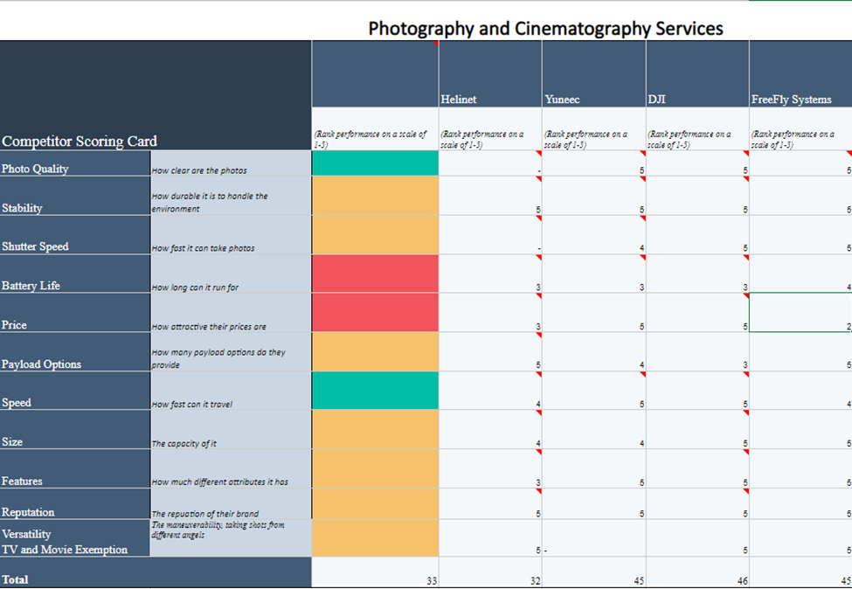
Photography & Cinematography
Notes:
Allyson Garay

Slide 60
Competitor Score Card
Helinet (score 32)
They do not promote use of their own payloads (unknown if they even make payloads). Instead, they use the payloads of other companies such as DJI and FreeFly.
Helinet received a score of 0 for the criteria of photo quality and payload options.
Additionally, their battery life and price received a score of 3 because they are not appealing to production companies with limited budgets.
Mainly focuses on providing aerial vehicles for news broadcasting systems and not as much for film productions they way the other companies do.
DJI (Score 46)
They have extensive work with production companies and crew, this results in drones and payloads that provide high quality images with low prices.
Despite not having many payload options that are easily interchangeable, the few that they do have surpass that of other companies with integrated AI technology that appeals to film production companies.
Several features, including AI and VR controls
Notes:
Allyson Garay

Slide 61
Competitor Score Card
Yuneec (Score 45)
Yunnec had balanced scores all throughout the criteria, having a lot of versatility amongst its drone and payload capabilities.
Yuneec only fell short in its battery life with a score of 3, however this is not uncommon as all other companies also struggled with this criterion.
Firefly Systems (Score 45)
Like DJI they also work intensively with production companies and crew to obtain feedback on how to better improve their drones for this specific industry.
The only reason it fell short and behind DJI is due to their prices. Freefly Systems received a score of 2 because it has the highest prices out of all the other companies, making it inaccessible for small production companies.
Several payload options that are easily interchangeable and allow versatility when filming.
Notes:
Allyson Garay

Slide 62
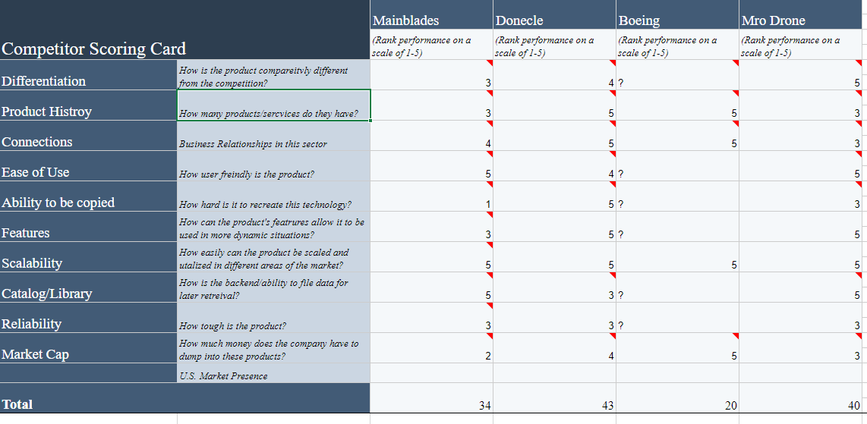
Plane Inspections
Notes:
Zacharias Beck
Integration
ease of integrating a drone into an already existing proces
Versatility
used for many reasons such as inventory management, inspections, etc
Uniqueness
distinguish itself from traditional tools used within warehousing such as warehouse pickers which are extremely unsafe.
Scalability
a scalable drone solution can help with adapting to the increasing demands of warehouse operations
variety of products
adaptability and applicability in different warehouse environments
Cost
providing a good return on investment to clients is key to be a top competitor
integration of software
Being able to easily use the software
ease of use
speed of data retrieval
accuracy

Slide 63
Competitor card
Mainblades (score 34)
Standard product with a focus on training and implementation
EU-based with contracts in multiple airports
Emphasis on user-friendliness and scalability
Strength in software and backend systems
Smaller-cap company in the market
Donecle (score 43)
Patented sensors as a key product differentiator
Established presence and reputation in the global aerospace sector
Technology appears to be plug-and-play
Unique features, especially advanced sensors, offer superior data generation
Market Cap is unknown
Notes:
Zacharias Beck

Slide 64
Competitor card
Boeing (score not applicable)
Aerospace giant with limited public information on specific offerings
Known contracts and products being tested with the U.S. Air Force
Strong, established global connections in public and private markets
Substantial market cap provides significant investment potential in new technologies
Mro Drone (score 40)
Newcomer in aerospace market with innovative product and software solutions.
Specializes in integrated approach, combining simple components synergistically for superior performance.
Target market primarily consists of smaller airfields and customers.
Demonstrating growth and recognition within the industry.
Notes:
Zacharias Beck

Slide 65
Market Insights and Recommendations
Market Challenges: High competition, regulatory hurdles, and significant startup costs in the aerospace market.
Innovation Strategy: Consider focusing on developing a patentable or unique product feature to stand out.
Attracting Larger Players: Innovations could attract interest from larger companies like Boeing for licensing or acquisition, offering a strategic entry point.
Overall Assessment: At this stage, the aerospace market may not be the best fit for Apollon Company due to high startup/development costs, the amount of regulation, and level of competition
Notes:
Zacharias Beck

Slide 66
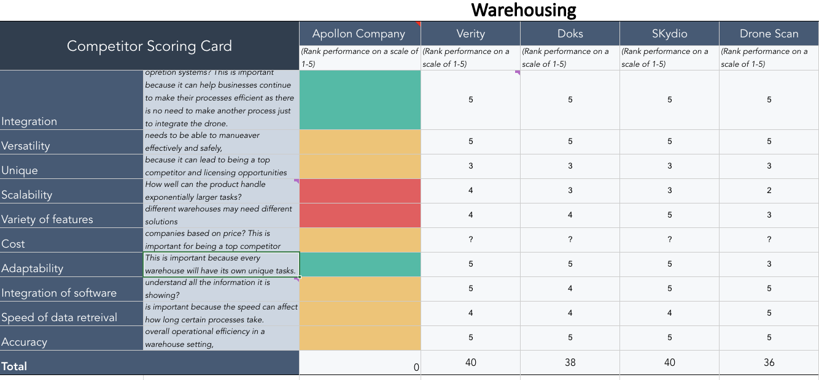
Warehousing
Notes:
WENDY OBISPO
Integration
ease of integrating a drone into an already existing proces
Versatility
used for many reasons such as inventory management, inspections, etc
Uniqueness
distinguish itself from traditional tools used within warehousing such as warehouse pickers which are extremely unsafe.
Scalability
a scalable drone solution can help with adapting to the increasing demands of warehouse operations
variety of products
adaptability and applicability in different warehouse environments
Cost
providing a good return on investment to clients is key to be a top competitor
integration of software
Being able to easily use the software
ease of use
speed of data retrieval
accuracy

Slide 67
Competitor card
Verity (Score: 40):
Ability to create a digital warehouse model using onboard cameras.
Enhanced accuracy and adaptability of drones.
Convenient scheduling for specific checks or facility-wide inspections.
Verity Cloud software for seamless operational integration.
Doks (Score: 38):
Powerful and accurate sensors, though lacking unique features.
Night flight mode for operations in dark environments.
Image creation for every captured object aids in organization.
Emphasis on accuracy of location data.
Notes:
WENDY OBISPO

Slide 68
Competitor card
Skydio (Score: 40):
Utilizes artificial intelligence-driven navigation for uniqueness.
Enhanced obstacle avoidance and data retrieval accuracy.
Fast and efficient data capture for warehouse environment mapping.
Scheduled mapping capabilities similar to Verity.
Drone Scan (Score: 36):
Hummingbird attachment for specific drones.
Simplified attachment process for inspection purposes.
Inventory management barcode rate of 2 seconds per item.
Pallet inspection rate of 5 seconds per unit.
Notes:
WENDY OBISPO

Slide 69
Why the Warehouse Drone Industry is the best fit
Market Fit for Apollon:
Apollon's ideal fit in the warehouse industry positions it as a potent market competitor.
Ongoing industry growth provides strategic opportunities for Apollon's market entry.
Industry Growth Advantage:
The dynamic growth within the warehouse sector enhances Apollon's market insertion potential.
Strategic Differentiation:
The Apollon company can set themselves apart
Notes:
WENDY OBISPO

Slide 70
Warehouse Drone Industry

Slide 71
Constraints and Technical Requirements
Notes:
WENDY OBISPO

Slide 72
Segmentation
Typically, smaller warehouses are used as storage facilities and larger warehouses provide easy access to highways and loading docks.
In North America, the largest ports are in Los Angeles, Long Beach, New York and New Jersey, Georgia (more specifically Savannah and Brunswick), Seattle-Tacoma, Houston, Oakland, South Carolina, Port Metro Vancouver, and Virginia.
Skydio’s price of $999 can serve as a benchmark
any industry that has to do with fulfillment, picking, packing, and fulfilling orders may benefit from drones.
inventory accuracy is important in, “supply chain management and retail, as it directly impacts the efficiency of operations, customer satisfaction, and financial performance.”
Notes:
WENDY OBISPO

Slide 73
Constraints
The FAA does not regulate the usage of drones in an indoor setting
In order to use drones autonomously beyond the visual line of sight, operators need to have a waiver from the FAA
Safety issues:
Risk of flying into people
damage to machinery
interference between signals
What makes a drone considered safe:
Propeller guards
Plastic propellers
Safety signs
Notes:
WENDY OBISPO

Slide 74
Repetitive Injury Findings
Using Drones for Cycle Counting
Decreases the need for workers in repetitive tasks.
Significantly reduces the risk of injuries from repetitive motion.
Enhances operational efficiency and leads to substantial cost savings.
A single drone can replace a team of cycle counters
Broken down in research discoveries
Statistics (OSHA, 2012)
Repetitive motion injuries: 3.0 incidents per 10,000 workers.
Overexertion injuries: 12.5 incidents per 10,000 workers.
Repetitive motion often contributes to overexertion cases.
Notes:
Zacharias Beck

Slide 75
Customer Discovery Findings

Slide 76
Customer Discovery Findings
Common Theme: Cost as a Determining Factor:
Cost is a significant factor influencing the decision on drone adoption in warehouses.
Cost of drones, services, space expansion, and staff training, are critical in the decision-making process.
Fulfillment World in Pico Rivera:
Warehouse does not currently use drones due to suspected budget constraints.
Expresses significant interest in drone implementation for safety and efficiency, particularly for inspecting high racks.
Cal Poly Pomona Alumni Insights:
Safety concerns, costs, and training as reasons for not using drones.
Believes drones could provide benefits in saving ground space and reaching difficult-to-access areas but acknowledges cost challenges.
Notes:
WENDY OBISPO

Slide 77
Customer Discovery Findings
RFID's Growing Importance
RFID crucial for modern warehousing practices.
Retail giants like Walmart and Macy's mandate RFID.
Adapting to advanced systems is essential.
Dave's Enthusiasm and Market Gap
Dave's excitement about drone integration highlights potential.
Reveals a gap in current market offerings.
The Ideal Product
Drone-based solution for RFID-equipped cycle counting.
Automates and enhances accuracy in inventory management.
Cost-effective: $50,000 initial installation, $200 per drone, economically competitive.
Positioning in Technological Advancements
Amid warehousing advancements, drone-based cycle counting offers a unique approach.
Differentiates from technologies like Libiarobot and Kardex ASRS..
Information taken from Interview with David Ardolino (Warehouse Consultant)
Notes:
Zacharias Beck

Slide 78
Customer Discovery Findings
Common Problem: GPS
Very difficult to control drones in warehouses
Nothing much they can do with this problem because it is something they can control or fix to improve
Tech in their Company
Warehouse are seem to be outdated and not suitable for technology to be incorporated into it
Companies want to be able to keep track of inventory as efficient as it can
Miscellaneous
Companies are unaware of the benefits on drones and not likely brought up to the company
Price is also a strong factor if companies are willing to invest in drones
Notes:
Alex

Slide 79
Discussion and Recommendations

Slide 80
Perspective
Promising Opportunity
Dr. Anhdoh's interests align with the warehousing drone industry.
Industry in early stages, poised for significant growth.
Market Composition and Receptiveness
Few major players, ample room for new entrants.
Recognized need for drone technology in warehouses.
Vast potential customer base in the US warehouses.
Untapped Niche
Warehouse drone technology for inventory management is largely untapped.
Unique niche for The Apollon Company to capitalize on.
Educational Challenge and Opportunity
Market lacks awareness of drone technology benefits.
Challenge: Educate the market.
Opportunity: Market penetration and brand establishment.
Notes:
Zacharias Beck

